Slide 1
CS 3104 – OPERATING SYSTEMS
Chapter 6
Synchronization Tools

Slide 2
CHAPTER 6: SYNCHRONIZATION TOOLS
Background
The Critical-Section Problem
Peterson’s Solution
Hardware Support for Synchronization
Mutex Locks
Semaphores
Monitors
Liveness
Evaluation

Slide 3
OBJECTIVES
Describe the critical-section problem and illustrate a race condition
Illustrate hardware solutions to the critical-section problem using memory barriers, compare-and-swap operations, and atomic variables
Demonstrate how mutex locks, semaphores, monitors, and condition variables can be used to solve the critical-section problem
Evaluate tools that solve the critical-section problem in low-, moderate-, and high-contention scenarios

Slide 4
RECALL
A system typically consists of several (perhaps hundreds or even thousands) threads running either concurrently or in parallel.
Threads often share user data.
Meanwhile, the operating system continuously updates various data structures to support multiple threads.

Slide 5
RECALL
Processes executing concurrently in the operating system may be either:
independent processes
cooperating processes
Independent Process:
A process that does not share data with any other processes executing in the system.
Cooperating process:
A process that can affect or be affected by the other processes executing in the system.
A process that shares data or resources with other processes executing in the system.

Slide 6
COOPERATING PROCESS
Recall: A process that can affect or be affected by other processes executing in the system
Requires an interprocess communication (IPC) mechanism that allows it to exchange data with another process
It can either:
directly share a logical address space (that is, both code and data), or
be allowed to share data only through shared memory or message passing
Concurrent access to shared data may result in data inconsistency

Slide 7
PROCESS SYNCHRONIZATION
It is a way to coordinate processes that use shared data which occurs in an operating system among cooperating processes.
It helps to maintain shared data consistency and cooperating process execution while executing many concurrent processes.
Processes have to be scheduled to ensure that concurrent access to shared data does not create inconsistencies.
Data inconsistency can result in what is called a race condition.
Involves using tools that control access to shared data to avoid race conditions.
These tools must be used carefully, as their incorrect use can result in poor system performance, including deadlock.

Slide 8
PROCESS SYNCHRONIZATION
The task of coordinating the execution of processes in a way that no two processes can have access to the same shared data and resources.
It is specially needed in a multi-process system when multiple processes are running together, and more than one processes try to gain access to the same shared resource or data at the same time.
This can lead to the inconsistency of shared data.
So the change made by one process is not necessarily reflected when other processes accessed the same shared data.
To avoid this type of inconsistency of data, the processes need to be synchronized with each other.

Slide 9
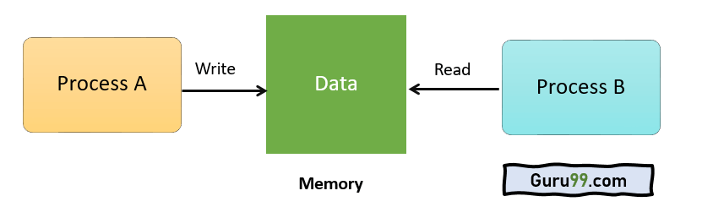
HOW DOES PROCESS SYNCHRONIZATION WORK?
Example:
Process A changing the data in a memory location while another process B is trying to read the data from the same memory location.
There is a high probability that the data read by the second process will be erroneous.

Slide 10
BACKGROUND
Processes can execute concurrently or in parallel
May only partially complete execution before another process is scheduled
May be interrupted at any time (processor core is assigned to another process)
Recall: Concurrent access to shared data may result in data inconsistency
Maintaining data consistency requires mechanisms to ensure the orderly execution of cooperating processes

Slide 11
BACKGROUND
PRODUCER PROCESS: SHARED MEMORY
item next_produced;
while (true) {
/* Produce an item and store it in next_produced */
next_produced = makeNewItem(…);
/* Wait for space to become available */
while (((in + 1) % BUFFER_SIZE) == out)
; /* Do nothing */
/* Then store the item and repeat the loop */
buffer[in] = next_produced;
in = (in + 1) % BUFFER_SIZE;
}
The producer process has a local variable next_produced in which the new item to be produced is stored.

Slide 12
BACKGROUND
CONSUMER PROCESS: SHARED MEMORY
item next_consumed;
while (true) { /* Wait for an item to become available */
while (in == out)
; /* Do nothing */ /* Get the next available item */
next_consumed = buffer[out];
out = (out + 1) % BUFFER_SIZE;
/* consume the item in next_consumed */
}
The consumer process has a local variable next_consumed in which the item to be consumed is stored.
One issue this illustration does not address concerns the situation in which both the producer process and the consumer process attempt to access the shared buffer concurrently.

Slide 13
BACKGROUND: PROBLEM ILLUSTRATION AND SOLUTION
Suppose that we wanted to provide a solution to the consumer-producer problem that fills all the buffers.
Solution:
Having an integer counter that keeps track of the number of full buffers.
Initially, counter is set to 0.
It is incremented by the producer after it produces a new buffer.
It is decremented by the consumer after it consumes a buffer.

Slide 14
PRODUCER PROCESS
while (true)
{ /* produce an item in next_produced */
while (counter == BUFFER_SIZE)
; /* do nothing */
buffer[in] = next_produced;
in = (in + 1) % BUFFER_SIZE;
counter++;
}

Slide 15
CONSUMER PROCESS
while (true)
{
while (counter == 0)
; /* do nothing */
next_consumed = buffer[out];
out = (out + 1) % BUFFER_SIZE;
counter--;
/* consume the item in next_consumed */
}

Slide 16
RACE CONDITION: OBSERVATIONS
Unfortunately, a new problem is introduced because both the producer and the consumer processes are adjusting the value of the variable counter, which can lead to a condition known as a race condition.
In this condition, a piece of code may or may not work correctly, depending on which of the two simultaneous processes executes first, and more importantly, if one of the processes gets interrupted such that the other process runs between important steps of the first process.

Slide 17
RACE CONDITION: OBSERVATIONS
Question:
"Each of those are single instructions, how can they get interrupted halfway through?"
Answer:
Although they are single instructions, they are actually three steps each at the hardware level:
Fetch counter from memory into a register,
Increment or decrement the register, and
Store the new value of counter back to memory.
The particular problem above comes from the producer executing "counter++" at the same time the consumer is executing "counter--".
If one process gets part way through making the update and then the other process butts in, the value of the counter can get left in an incorrect state.

Slide 18
RACE CONDITION: ILLUSTRATION
If the instructions from the two processes get interleaved, there could be serious problems, such as illustrated by the following:
Producer: counter++ could be implemented as:
register1 = counter
register1 = register1 + 1
counter = register1
Consumer: counter-- could be implemented as:
register2 = counter
register2 = register2 – 1
counter = register2
Consider this execution interleaving with “counter = 5” initially:
S0: producer execute register1 = counter {register1 = 5}
S1: producer execute register1 = register1 + 1 {register1 = 6}
S2: consumer execute register2 = counter {register2 = 5}
S3: consumer execute register2 = register2 – 1 {register2 = 4}
S4: producer execute counter = register1 {counter = 6}
S5: consumer execute counter = register2 {counter = 4}

Slide 19
RACE CONDITION
A situation where several processes access and manipulate the same data concurrently and the outcome of the execution depends on the particular order in which the access takes place.
Example:
Incorrect state is obtained when both processes are allowed to manipulate the variable counter concurrently (previous illustration).
A condition that occurs when two or more operations are executed at the same time, not scheduled in the proper sequence, and not exited in the critical section correctly.

Slide 20
RACE CONDITION
A condition that exists when access to shared data is not controlled and resulting in corrupt data values.
A situation that may occur inside a critical section.
This happens when the result of multiple thread execution in the critical section differs according to the order in which the threads execute.

Slide 21
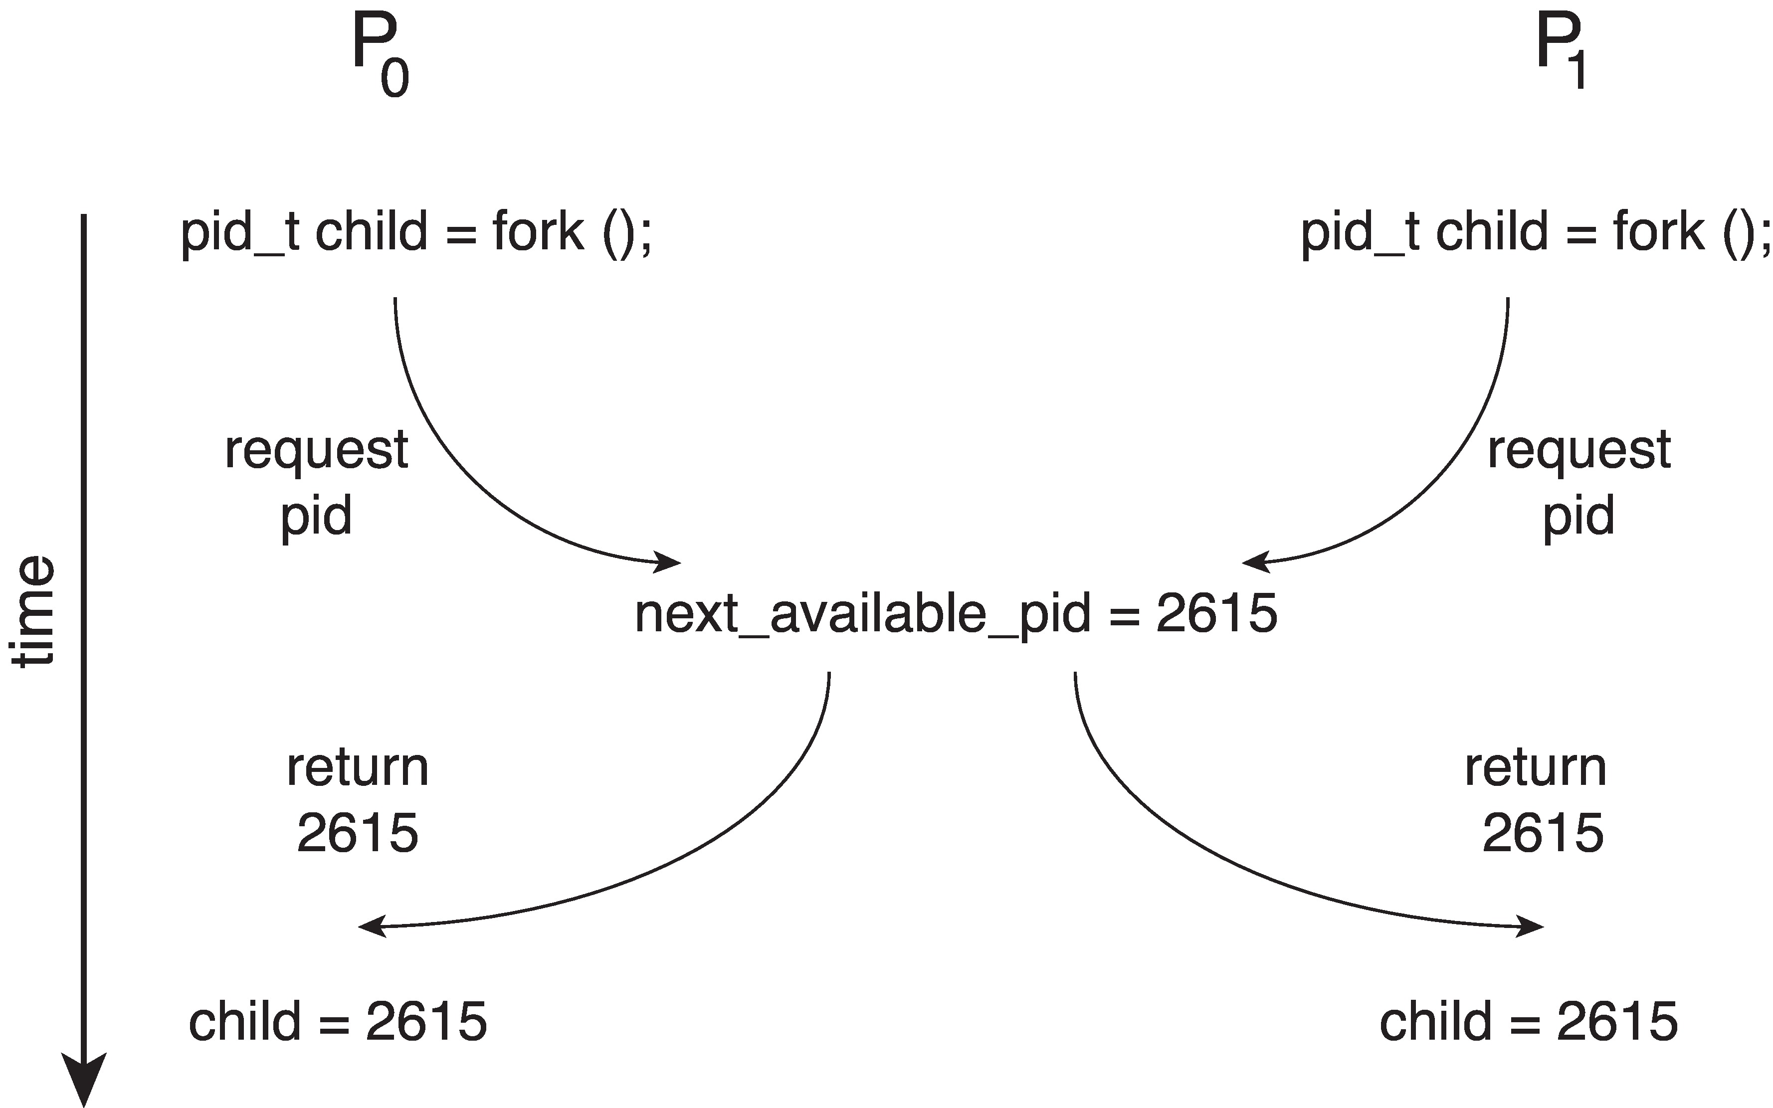
RACE CONDITION: EXAMPLE ILLUSTRATION
Processes P₀ and P₁ are creating child processes using the fork() system call
Race condition on kernel variable next_available_pid which represents the next available process identifier (pid):
Unless there is mutual exclusion, the same pid could be assigned to two different processes.
Recall:
The fork() returns the process identifier of the newly created process to the parent process.

Slide 22
CRITICAL SECTION
A segment of code that can be accessed by only one signal process at a certain instance in time.
This section consists of shared data resources that need to be accessed by other processes.
The entry to the critical section is handled by the wait() function, represented as P().
The exit from a critical section is controlled by the signal() function, represented as V().
Only one process can be executed inside the critical section at a time.
Other processes waiting to execute their critical sections have to wait until the current process finishes executing its critical section.
A code segment that accesses shared variables and has to be executed as an atomic action.
It means that in a group of cooperating processes, at a given point of time, only one process must be executing its critical section.
If any other process also wants to execute its critical section, it must wait until the first one finishes.

Slide 23
CRITICAL SECTION PROBLEM
Consider a system of n processes {P₀, P₁, … P_{n-1}}.
Each process has a segment of code (critical section):
process may be accessing (and updating) data that is shared with at least one other process
process may be changing common variables, updating table, writing file, etc.
when one process is in its critical section, no other is allowed to execute in its critical section

Slide 24
CRITICAL SECTION PROBLEM
Critical-Section Problem:
To design a protocol that the processes can use to synchronize their activity so as to cooperatively share data.
The producer-consumer problem described above is a specific example of a more general situation known as the critical-section problem.

Slide 25
CRITICAL SECTION PROBLEM
The general idea is that in a number of cooperating processes, each has a critical section of code, with the following conditions and terminologies:
Conditions:
Only one process in the group can be allowed to execute in their critical section at any one time.
If one process is already executing their critical section and another process wishes to do so, then the second process must be made to wait until the first process has completed their critical section work.
Terminologies:
The code preceding the critical section, and which controls access to the critical section, is termed the entry section.
It acts like a carefully controlled locking door.
The code following the critical section is termed the exit section.
It generally releases the lock on someone else's door, or at least, lets the world know that they are no longer in their critical section.
The rest of the code not included in either the critical section or the entry or exit section is termed the remainder section.

Slide 26
REMINDER: CRITICAL SECTION ELEMENTS
Entry Section:
It is the part of the process which decides the entry of a particular process.
Critical Section:
This part allows one process to enter and modify the shared variable.
Exit Section:
This section allows the other process that are waiting in the Entry Section, to enter into the Critical Section.
It also checks that a process that finished its execution should be removed through this Section.
Remainder Section:
All other parts of the Code (which is not in Critical, Entry, and Exit Section) are known as the Remainder Section.

Slide 27
CRITICAL SECTION PROBLEM: IMPORTANT NOTES
Only one process can be in the critical section:
When one process is in critical section, no other may be in its critical section
Each process must ask permission to enter critical section in entry section
The permission should be released in exit section
Then other parts of the code are the remainder section

Slide 28
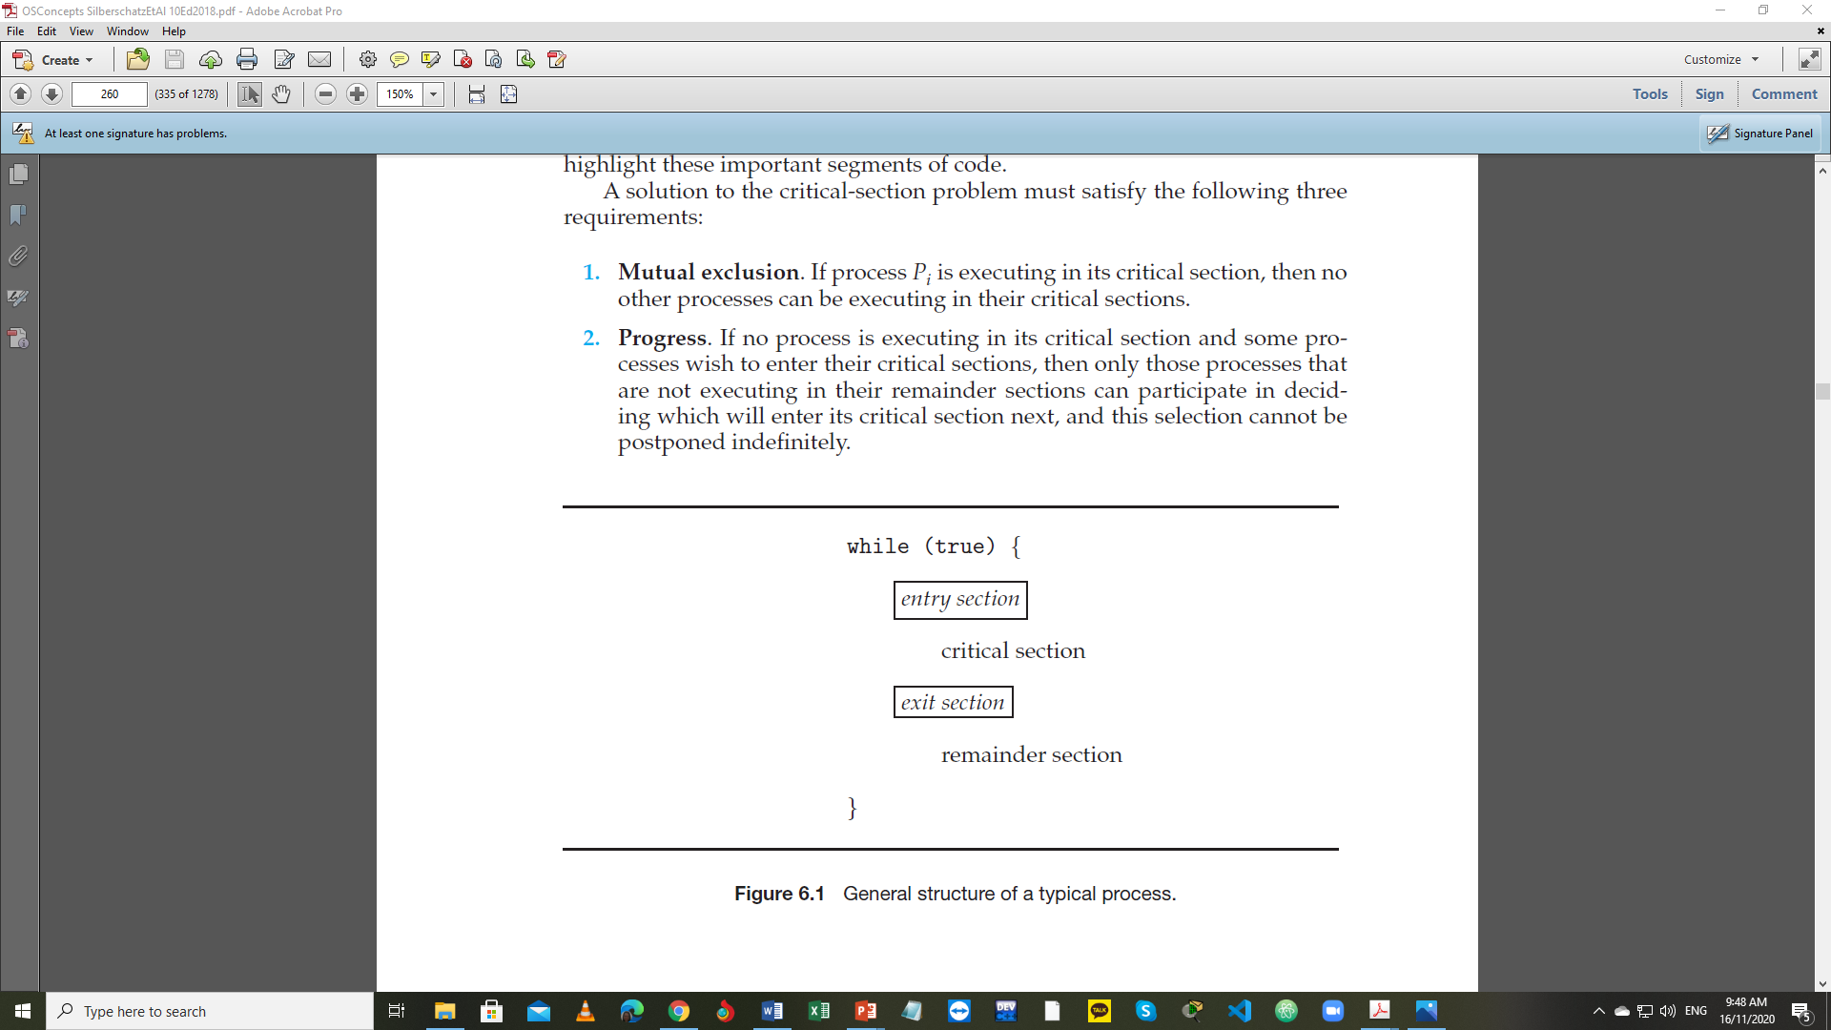
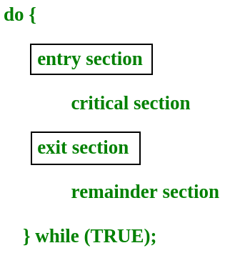
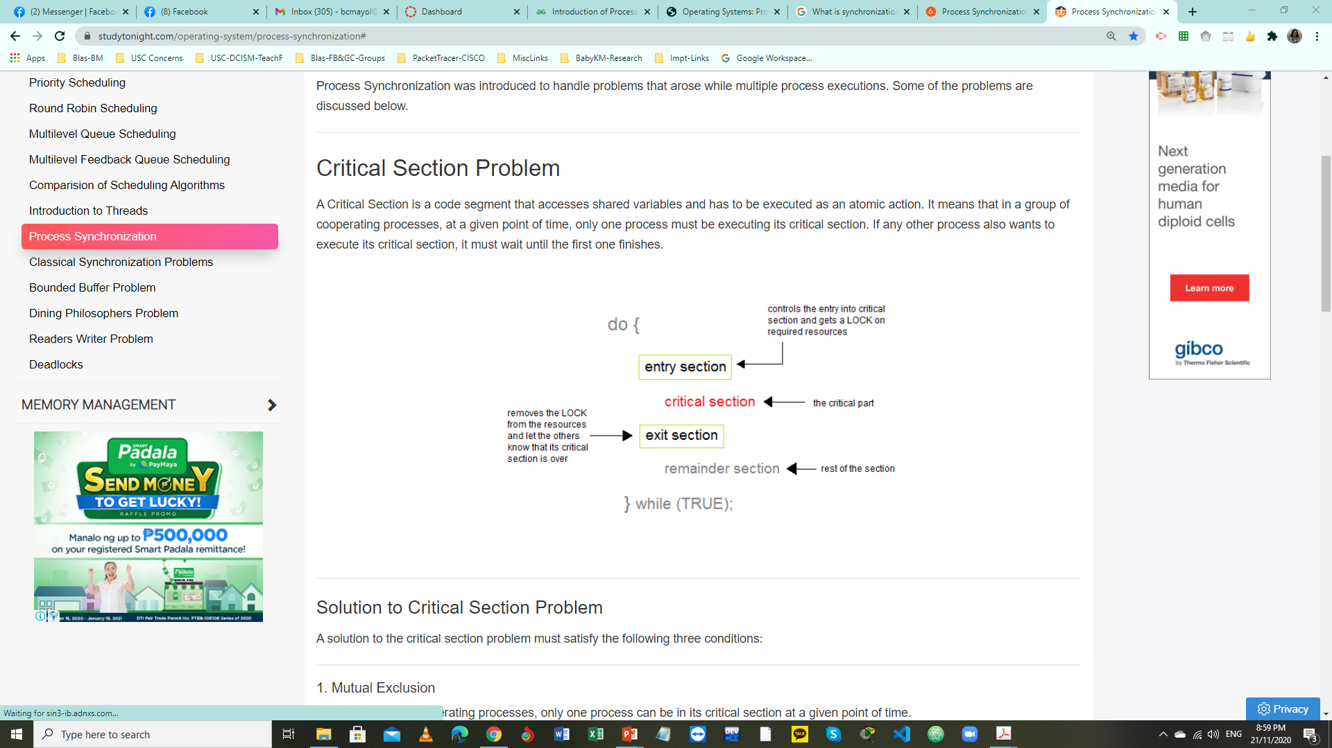
GENERAL STRUCTURE OF A PROCESS: P_{i}
or
or

Slide 29
CRITICAL SECTION PROBLEM: CONDITIONS
1. | Mutual Exclusion | If a process is executing in its critical section, then no other processes can be executing in their critical sections.
 |  | Out of a group of cooperating processes, only one process can be in its critical section at a given point of time.

Slide 30
CRITICAL SECTION PROBLEM: CONDITIONS
2. | Progress | If no process is executing in its critical section and there exist some processes that wish to enter their critical section, then the selection of the processes that will enter the critical section next cannot be postponed indefinitely.
 |  | If no process is currently executing in their critical section, and one or more processes want to execute their critical section, then only the processes not in their remainder sections can participate in the decision, and the decision cannot be postponed indefinitely ( i.e. processes cannot be blocked forever waiting to get into their critical sections. )

Slide 31
CRITICAL SECTION PROBLEM: CONDITIONS
3. | Bounded Waiting | A bound, or limit, must exist on the number of times that other processes are allowed to enter their critical sections after a process has made a request to enter its critical section and before that request is granted.
 |  | There exists a limit as to how many other processes can get into their critical sections after a process requests entry into their critical section and before that request is granted (i.e. a process requesting entry into their critical section will get a turn eventually, and there is a limit as to how many other processes get to go first).

Slide 32
CRITICAL SECTION PROBLEM: REMINDERS
MUTUAL EXCLUSION applies only to the CS and the Exit sections.
However, the other three sections are not exclusive
PROGRESS condition is used to make sure that:
either some process is currently in the CS and doing some work or,
if there was at least one process that wanted to enter the CS, it will and then do some work.
In both cases, some work is getting done and therefore, all processes are making progress overall.
BOUNDED WAITING condition is used to make sure that every process gets the chance to actually enter its critical section so that no process starves forever.
The number of times other processes enter their CSs must be limited.
However, please note that neither this condition nor progress guarantees fairness.
An implementation of a CS doesn't have to be fair.

Slide 33
CRITICAL SECTION HANDLING IN OS
Reminder:
Kernel processes can also be subject to race conditions which can be especially problematic when updating commonly shared kernel data structures such as open file tables or virtual memory management.
Kernel can take on one of two approaches:
Preemptive |  | Nonpreemptive
Allows preemption of process when running in kernel mode |  | Runs until exits kernel mode, blocks, or voluntarily yields CPU
Allows for real-time operations, but must be carefully written to avoid race conditions |  | Does not allow processes to be interrupted while in kernel mode
Can be especially tricky on SMP systems (multiple kernel processes may be running simultaneously on different processors) |  | Essentially free of race conditions in kernel mode
Includes Linux 2.6 and later; Solaris; IRIX |  | Includes Windows XP; traditional UNIX

Slide 34
PETERSON’S SOLUTION
A classical software-based solution to the critical section problem
A widely used solution to critical section problems
Also known as Peterson’s Algorithm
A concurrent programming algorithm for mutual exclusion that allows two or more processes to share a single-use resource without conflict, using only shared memory for communication.
An algorithm developed by a computer scientist Gary L. Peterson in 1981, thus, the name Peterson's Solution.

Slide 35
PETERSON’S SOLUTION
Solves two-processes synchronization
Restricted to two processes that alternate execution between their critical sections and remainder sections
Assumes that LOAD and STORE machine-language instructions are ATOMIC.
ATOMIC: execution cannot be interrupted
While Peterson's original formulation worked with only two processes, the algorithm can be generalized for more than two (Filter Algorithm).

Slide 36
PETERSON’S SOLUTION
The two processes share two variables (flag & turn):
boolean flag[ i ]
Indicates when a process wants to enter or ready to enter to the critical section
When process i wants to enter their critical section, it sets flag[ i ] to true
flag[i] = true implies that process P_{i} is ready
Initialized to FALSE, initially no one is interested in entering the critical section
int turn
Indicates whose turn it is to enter into the critical section
If turn = i, then process i is allowed into the critical section

Slide 37
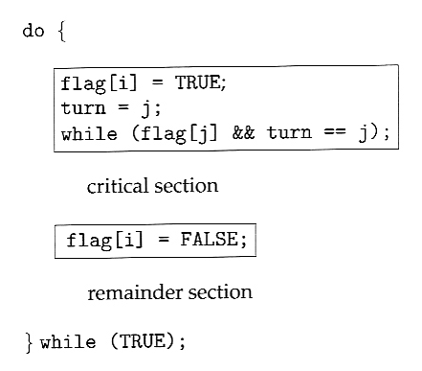
ALGORITHM FOR PROCESS P_{i}
In the entry section, process i first raises a flag indicating a desire to enter the critical section.
The while loop is a busy loop ( notice the semicolon at the end ), which makes process i wait as long as process j has the turn and wants to enter the critical section.
while (true){
flag[i] = true;
turn = j;
while (flag[j] && turn = = j)
;
/* critical section */
flag[i] = false;
/* remainder section */
}
Then turn is set to j to allow the process j to enter its critical section if process j so desires.
Process i lowers the flag[ i ] in the exit section, allowing process j to continue if it has been waiting.

Slide 38
PETERSON’S SOLUTION
Peterson’s Solution preserves all three conditions:
Mutual Exclusion is assured as only one process can access the critical section at any time.
Mutual Exclusion is preserved.
P_{i} enters CS only if:
either flag[j] = false or turn = i
Progress is also assured, as a process outside the critical section does not block other processes from entering the critical section.
Progress requirement is satisfied.
Bounded Waiting is preserved as every process gets a fair chance.
Bounded Waiting requirement is met.
Disadvantages of Peterson’s Solution
It involves Busy waiting
It is limited to 2 processes.

Slide 39
PETERSON’S SOLUTION: REMINDERS
Although useful for demonstrating an algorithm, this solution is not guaranteed to work on modern architectures.
due to vagaries of load and store operations
but illustrates good algorithmic description of solving the problem
Understanding why it will not work is also useful for better understanding race conditions.
To improve performance, processors and/or compilers may reorder operations that have no dependencies.
For single-threaded, this is alright as the result will always be the same.
For multithreaded, the reordering may produce inconsistent or unexpected results.

Slide 40
PETERSON’S SOLUTION: EXAMPLE
Given:
Consider the following data that are shared between two threads:
boolean flag = false; int x = 0;
where Thread 1 performs the statements
while (!flag) ; print x
and Thread 2 performs
x = 100; flag = true
Task:
What is the expected output?

Slide 41
PETERSON’S SOLUTION: ANSWER
The expected output is 100
Thread 1 outputs the value 100 for variable x
However, the operations for Thread 2 may be reordered by the processor as follows:
flag = true;
x = 100;
If this occurs, the output may be 0
Less obvious, the processor may also reorder the statements:
If this were to occur, Thread 1would output 0 for variable x (even if the instructions issued by Thread 2 were not reordered).
Thread 1
print x;
while (!flag)
;
Thread 2
x = 100;
flag = true;

Slide 42
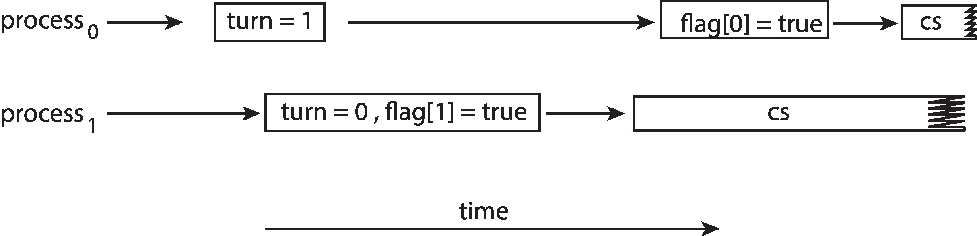
PETERSON’S SOLUTION
The effects of instruction reordering in Peterson’s Solution:
This allows both processes to be in their critical section at the same time.
Proper synchronization tools to preserve mutual exclusion:
primitive support in hardware
software-based APIs

Slide 43
HARDWARE SUPPORT FOR SYNCHRONIZATION
Many systems provide hardware support for implementing the critical section code.
Uniprocessors: could disable interrupts
Currently running code would execute without preemption
Generally, it is too inefficient on multiprocessor systems
Need to disable all the interrupts
Operating systems using this is not broadly scalable

Slide 44
FORM OF HARDWARE SUPPORT: 1) MEMORY BARRIER
Memory model:
The memory guarantees a computer architecture makes to application programs.
Categories of Memory Model:
Strongly ordered: where a memory modification of one processor is immediately visible to all other processors.
Weakly ordered: where a memory modification of one processor may not be immediately visible to all other processors.
Memory barrier:
An instruction that forces any change in memory to be propagated (made visible) to all other processors.

Slide 45
FORM OF HARDWARE SUPPORT: 1) MEMORY BARRIER
Consider the following data that are shared between two threads:
boolean flag = false; int x = 0;
where Thread 1 performs the statements
while (!flag) ; print x
and Thread 2 performs
x = 100; flag = true
We could add a memory barrier to the following instructions to ensure Thread 1 outputs 100:
Thread 1 now performs:
while (!flag) memory_barrier(); print x
Thread 2 now performs:
x = 100; memory_barrier(); flag = true

Slide 46
FORM OF HARDWARE SUPPORT: 2) HARDWARE INSTRUCTIONS
Special hardware instructions that:
allow us to either test-and-modify the content of a word, or
to swap the contents of two words atomically (uninterruptible way)
Types of Hardware Instructions:
test_and_set( ) instruction
compare_and_swap( ) instruction

Slide 47
test_and_set( ) INSTRUCTION
Definition:
boolean test_and_set(boolean *target)
{
boolean rv = *target;
*target = true;
return rv:
}
Executed atomically
Returns the original value of passed parameter
Set the new value of passed parameter to true

Slide 48
MUTUAL EXCLUSION IMPLEMENTATION: USING test_and_set ( )
Declared (shared) boolean variable lock, initialized to false
Solution:
do { while (test_and_set(&lock))
; /* do nothing */
/* critical section */
lock = false;
/* remainder section */
} while (true);

Slide 49
compare_and_swap( ) INSTRUCTION
Definition:
int compare_and_swap(int *value, int expected, int new_value)
{
int temp = *value;
if (*value == expected)
*value = new_value;
return temp;
}
Executed atomically
Returns the original value of passed parameter value
Set the variable value the value of the passed parameter new_value
but only if *value == expected is true
that is, the swap takes place only under this condition

Slide 50
MUTUAL EXCLUSION: USING compare_and_swap( )
Declared (shared) integer lock initialized to 0;
Solution:
while (true){ while (compare_and_swap(&lock, 0, 1) != 0)
; /* do nothing */
/* critical section */
lock = 0;
/* remainder section */
}

Slide 51
BOUNDED WAITING MUTUAL EXCLUSION: compare_and_swap( )
while (true) { waiting[i] = true; key = 1; while (waiting[i] && key == 1)
key = compare_and_swap(&lock,0,1);
waiting[i] = false;
/* critical section */
j = (i + 1) % n;
while ((j != i) && !waiting[j])
j = (j + 1) % n;
if (j == i)
lock = 0;
else
waiting[j] = false;
/* remainder section */
}

Slide 52
FORM OF HARDWARE SUPPORT: 3) ATOMIC VARIABLES
Typically, instructions such as compare_and_swap( ) are used as building blocks for other synchronization tools.
One tool is an atomic variable that provides atomic (uninterruptible) updates on basic data types such as integers and booleans.
Example:
The increment( ) operation on the atomic variable sequence ensures sequence is incremented without interruption:
increment(&sequence);

Slide 53
FORM OF HARDWARE SUPPORT: 3) ATOMIC VARIABLES
The increment( ) function can be implemented as follows:
void increment(atomic_int *v)
{
int temp;
do {
temp = *v;
}
while (temp != (compare_and_swap(v, temp, temp+1));
}

Slide 54
MUTEX LOCK
Previous hardware solutions are complicated and generally inaccessible to application programmers:
particularly on multi-processor machines, and
particularly because they are often platform-dependent
OS designers build software tools to solve critical section problem:
Simplest is mutex lock

Slide 55
MUTEX LOCK
Short for mutual exclusion lock
Protects a critical section and prevents race condition
Process must first acquire( ) the lock before entering the critical section
Process must then release( ) the lock when it exits the critical section
Boolean variable is used to indicate if lock is available or not
Calls to acquire( ) and release( ) must be atomic
Usually implemented via hardware atomic instructions [compare_and_swap( )]
But this solution requires busy waiting (main disadvantage: busy loop to block processes)
This lock, therefore, is called a spinlock (CPU just sits and spins while blocking the process ).

Slide 56
CRITICAL SECTION PROBLEM: SOLUTION USING LOCKS
while (true)
{
acquire lock
critical section
release lock
remainder section
}

Slide 57
MUTEX LOCK: acquire( ) & release( ) DEFINITIONS
acquire() { while (!available)
; /* busy wait */
available = false;;
}
release() {
available = true;
}
These two functions must be implemented atomically.
Both test_and_set( ) and compare_and_swap( ) can be used to implement these functions.

Slide 58
SEMAPHORE
Synchronization tool that:
can behave similarly to a mutex lock
can also provide more sophisticated ways for process to synchronize their activities.
Semaphore S:
An integer variable (to represent how many units of a particular resource is available)
Can only be accessed via two standard atomic (indivisible) operations:
wait( ): originally called P( ) – proberen: to test
signal( ): originally called V( ) – verhogen: to increment

Slide 59
SEMAPHORE
Definition of the wait( ) operation:
wait(S)
{
while (S <= 0)
; // busy wait
S--;
}
Definition of the signal( ) operation:
signal(S)
{
S++;
}

Slide 60
SEMAPHORE USAGE
Counting semaphore:
integer value that can range over an unrestricted domain
can be used to control access to a given resource
usually used to count the remaining number of some limited resource
the counter is initialized to the number of such resources available in the system
whenever the counting semaphore is greater than zero, then a process can enter a critical section and use one of the resources
when the counter gets to zero (or negative in some implementations), then the process blocks until another process frees up a resource and increments the counting semaphore with a signal call
Binary semaphore:
integer value that can range only between 0 and 1
same as a mutex lock
can be used to solve the critical section problem
can be seen as just a special case where the number of resources initially available is just one

Slide 61
SEMAPHORE USAGE
Synchronizes certain operations between processes
Solves various synchronization problems
Example:
Consider P₁ and P₂ that require S₁ to happen before S₂ :
Firstly, create a semaphore named synch (shared by the two processes) and initialize it to zero.
Then in process P1, insert the code:
S1;
signal(synch);
and in process P2, insert the code:
wait(synch);
S2;
Because synch was initialized to 0, process P2 will block on the wait until after P1 executes the call to signal.

Slide 62
SEMAPHORE IMPLEMENTATION WITH NO BUSY WAITING
With each semaphore, there is an associated waiting queue
Each entry in a waiting queue has two data items:
value (of type integer)
pointer to next record in the list
Two operations provided by the OS:
sleep( ) / block( ):
place the process invoking the operation on the appropriate waiting queue
wakeup( ):
remove one of the processes in the waiting queue and place it in the ready queue

Slide 63
SEMAPHORE IMPLEMENTATION WITH NO BUSY WAITING
Semaphore Structure Definition:
typedef struct {
int value;
struct process *list;
} semaphore;
wait(semaphore *S) {
S->value--;
if (S->value < 0) { add this process to S->list;
sleep();
}
}
signal(semaphore *S) {
S->value++;
if (S->value <= 0) { remove a process P from S->list;
wakeup(P);
}
}
wait( ) Semaphore Operation Definition:
signal( ) Semaphore Operation Definition:

Slide 64
SEMAPHORE IMPLEMENTATION
Must guarantee that no two processes can execute the wait( ) and signal( ) on the same semaphore at the same time
Thus, the implementation becomes the critical section problem where the wait( ) and signal( ) code are placed in the critical section
Could now have busy waiting in critical section implementation
But implementation code is short
Little busy waiting if critical section rarely occupied
NOTE:
Applications may spend lots of time in critical sections and, therefore, this is not a good solution

Slide 65
PROBLEMS WITH SEMAPHORES
Incorrect use of semaphore operations:
signal (mutex) …. wait (mutex)
wait (mutex) … wait (mutex)
signal(mutex);
...
critical section
...
wait(mutex);
wait(mutex);
...
critical section
...
wait(mutex);
Omitting of wait (mutex) and/or signal (mutex)
These (and others) are examples of what can occur when semaphores and other synchronization tools are used by programmers incorrectly.

Slide 66
MONITOR
Synchronization constructs that were created to overcome the problems caused by semaphores such as timing errors.
A synchronization mechanism that allows processes to have:
mutual exclusion: only one process can execute the method at a certain point in time
cooperation: the ability to make processes wait for certain conditions to be met
A high-level abstraction that provides a convenient and effective mechanism for process synchronization
Abstract Data Type (ADT): internal variables that are only accessible by code within the procedure
Why is this called “monitor”? Because it monitors how processes access some resources

Slide 67
MONITOR: FEATURES
Only one process at a time has mutually exclusive access to a critical section
Only one process may be active within the monitor at a time
Process running in a monitor could be blocked while waiting for certain conditions to be met
One process can notify others when conditions they are waiting on are met

Slide 68
PSEUDOCODE SYNTAX OF A MONITOR
monitor monitor-name
{
/* shared variable declarations */
function P1 ( . . . ) {. . .}
function P2 ( . . . ) {. . .}
.
.
.
function Pn ( . . . ) {. . .}
initialization code ( . . . ) {. . .}
}

Slide 69
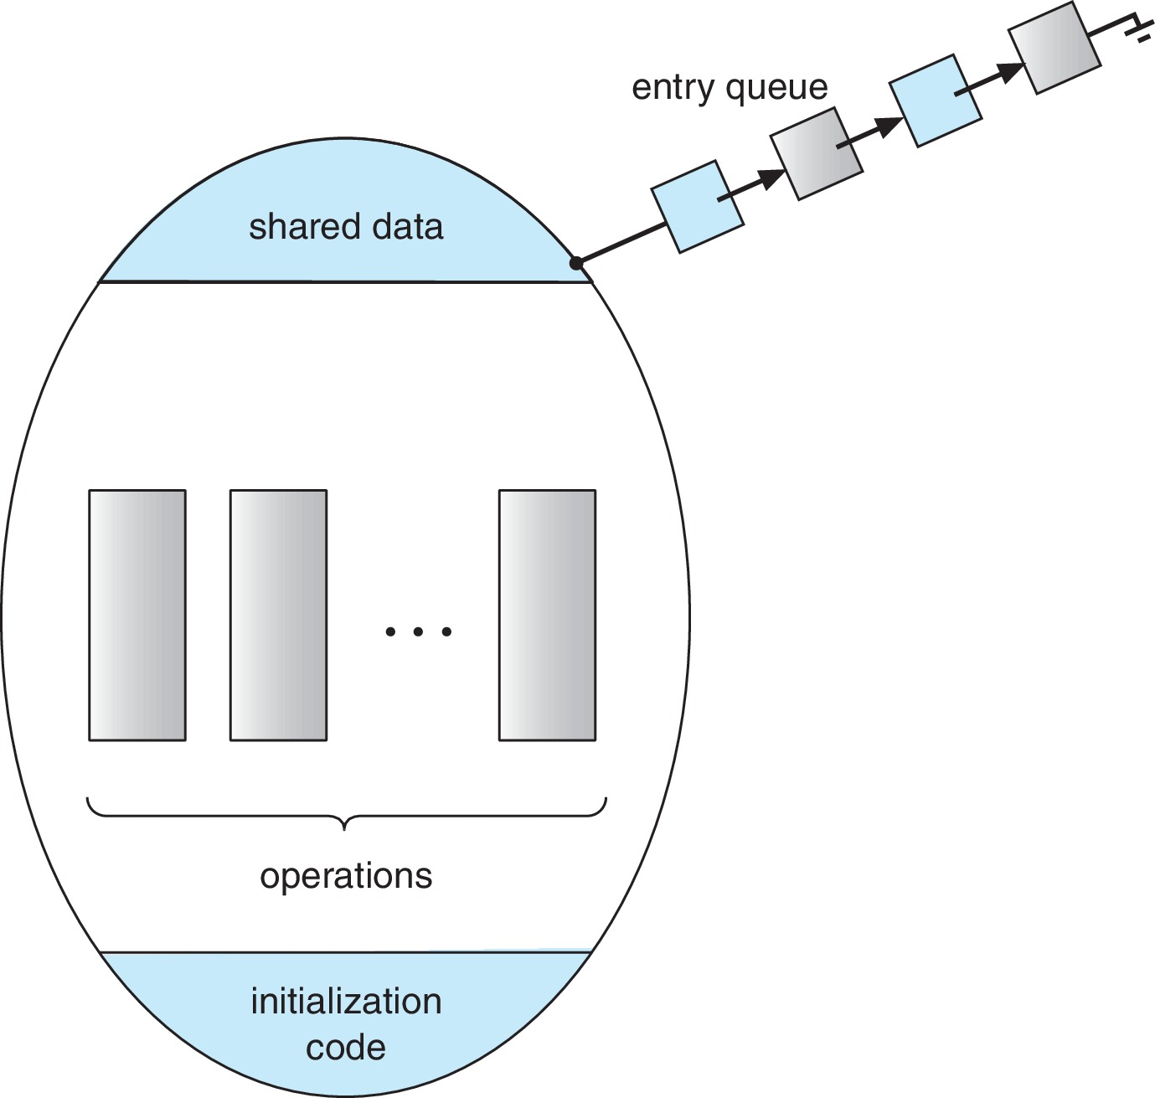
SCHEMATIC VIEW OF A MONITOR

Slide 70
CONDITION VARIABLES
condition x, y;
Two operations are allowed on a condition variable:
x.wait( )
a process that invokes the operation is suspended until x.signal( )
x.signal( )
resumes one of the processes (if any) that invoked x.wait( )
If no x.wait( ) on the variable, then it has no effect on the variable

Slide 71
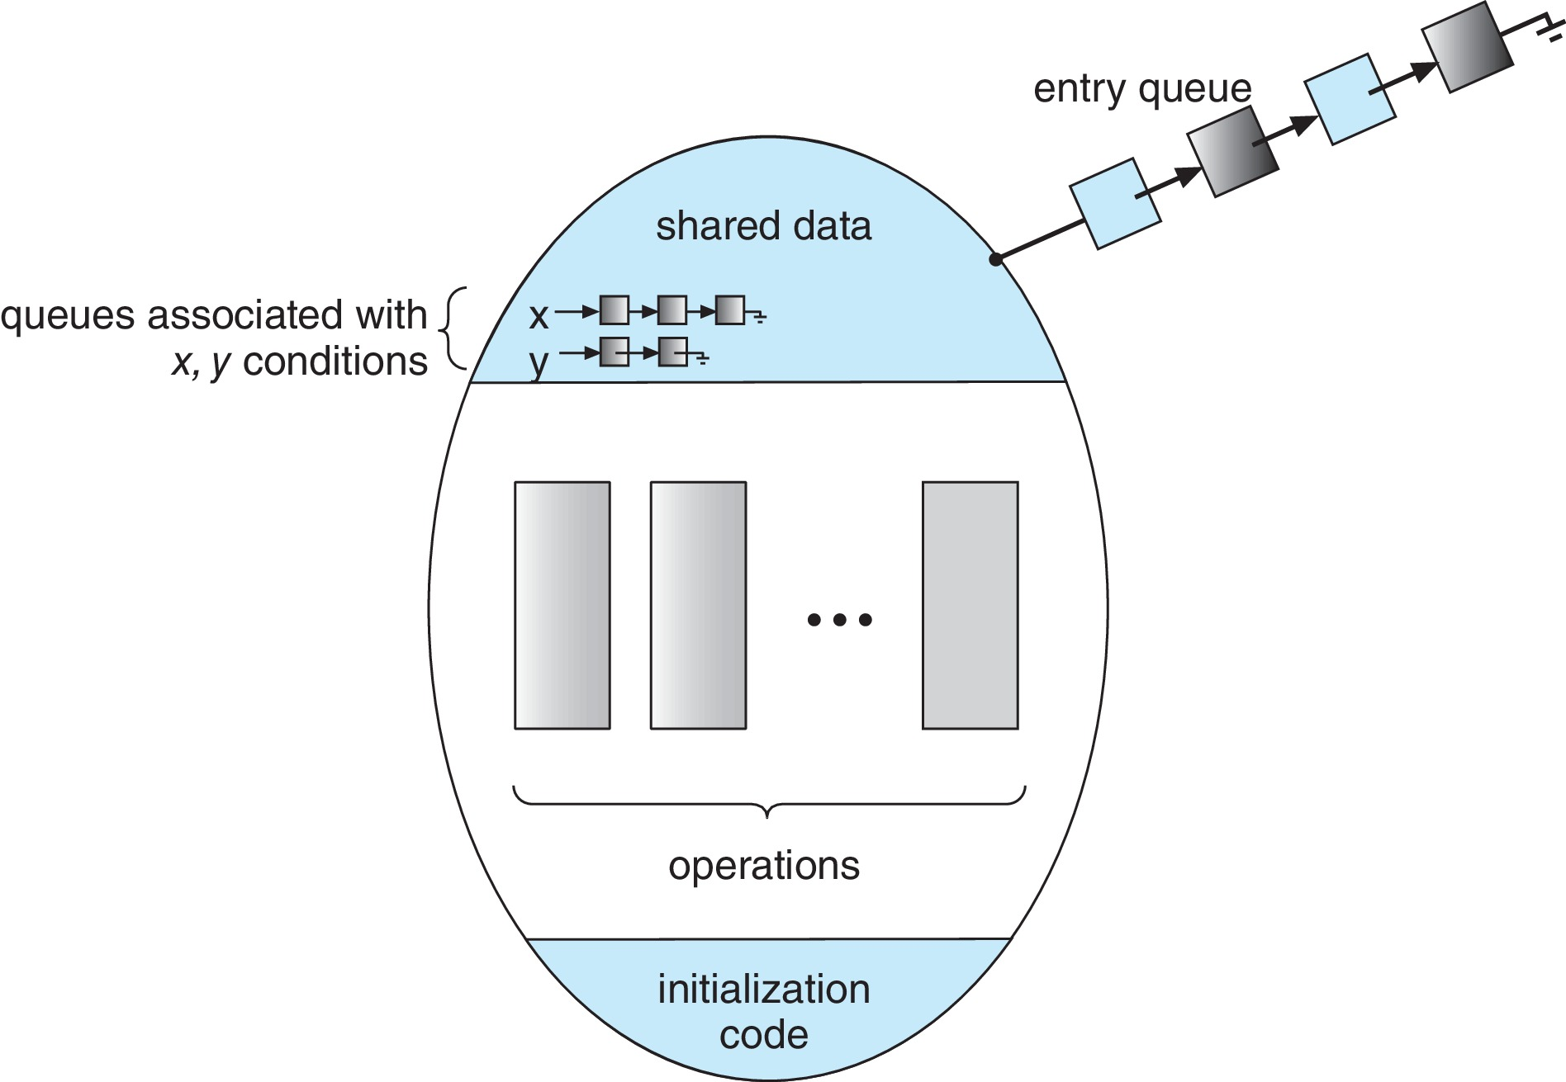
MONITOR WITH CONDITION VARIABLES

Slide 72
CONDITION VARIABLES OPTIONS
If process P invokes x.signal( ), and process Q is suspended in x.wait( ), what should happen next?
Both P and Q cannot execute in parallel; if Q is resumed, then P must wait
Options include:
Signal and wait:
P either waits until Q leaves the monitor or waits for another condition
Signal and continue:
Q either waits until P leaves the monitor or waits for another condition

Slide 73
MONITOR IMPLEMENTATION USING SEMAPHORES
Variables:
semaphore mutex; // (initially = 1)
semaphore next; // (initially = 0)
int next_count = 0;
Each function F will be replaced by:
wait(mutex);
...
body of F
...
if (next_count > 0)
signal(next);
else
signal(mutex);
Mutual exclusion within a monitor is ensured

Slide 74
MONITOR IMPLEMENTATION: CONDITION VARIABLES
For each condition variable x, we have:
semaphore x_sem; // (initially = 0)
int x_count = 0;
The operation x.wait( ) can be implemented as:
x_count++;
if(next_count > 0)
signal(next);
else
signal(mutex);
wait(x_sem);
x_count--;

Slide 75
MONITOR IMPLEMENTATION: CONDITION VARIABLES
The operation x.signal( ) can be implemented as:
if (x_count > 0)
{
next_count++;
signal(x_sem);
wait(next);
next_count--;
}

Slide 76
RESUMING PROCESSES WITHIN A MONITOR
If several processes queued on condition variable x, and x.signal( ) is executed, which process should be resumed?
Simple Solution: FCFS scheduling scheme
However, FCFS scheduling, frequently, is not adequate
Solution: conditional-wait construct
Form: x.wait(c);
where c is priority number
process with the smallest priority number (highest priority) is scheduled next

Slide 77
SINGLE RESOURCE ALLOCATION
Allocates the single resource among competing processes using priority numbers that specify the maximum time a process plans to use the resource, with the following sequence:
Where R is an instance of type ResourceAllocator
R.acquire(t);
...
access the resource;
...
R.release();

Slide 78
A MONITOR TO ALLOCATE SINGLE RESOURCE
monitor ResourceAllocator
{
boolean busy;
condition x;
void acquire(int time) {
if (busy)
x.wait(time);
busy = true;
}
void release() {
busy = false;
x.signal();
}
initialization_code() {
busy = false;
}
}

Slide 79
LIVENESS
Processes may have to wait indefinitely while trying to acquire a synchronization tool such as a mutex lock or semaphore.
Waiting indefinitely violates the progress and bounded waiting criteria as discussed.
Liveness: a set of properties that a system must satisfy to ensure that processes make progress during their execution life cycle.
Indefinite waiting is an example of a liveness failure.
Example: Infinite loop

Slide 80
LIVENESS
Deadlock: two or more processes are waiting indefinitely for an event that can be caused by only one of the waiting processes
Let S and Q be two semaphores initialized to 1
Consider if P₀ executes wait(S) and P₁ executes wait(Q).
When P₀ executes wait(Q), it must wait until P₁ executes signal(Q).
However, P₁ is waiting until P₀ executes signal(S).
Since these signal( ) operations will never be executed, P₀ and P₁ are deadlocked.
P₀ | P₁
wait(S); | wait(Q);
wait(Q); | wait(S);
. . . | . . .
signal(S); | signal(Q);
signal(Q); | signal(S);

Slide 81
LIVENESS
Other forms of deadlock:
Starvation:
indefinite blocking
a process may never be removed from the semaphore queue in which it is suspended
Priority Inversion:
scheduling problem when lower-priority process holds a lock needed by higher-priority process
Solved via priority-inheritance protocol

Slide 82
PRIORITY INHERITANCE PROTOCOL
Consider the following scenario:
There are three processes P1, P2, and P3.
P1 has the highest priority, P2 the next highest, and P3 the lowest.
Assume a resource P3 is assigned a resource R that P1 wants.
Thus, P1 must wait for P3 to finish using the resource.
However, P2 becomes runnable and preempts P3.
What has happened is that P2, a process with a lower priority than P1, has indirectly prevented P3 from gaining access to the resource.

Slide 83
PRIORITY INHERITANCE PROTOCOL
To prevent the above problem from occurring, a priority inheritance protocol is used.
This simply allows the priority of the highest thread waiting to access a shared resource to be assigned to the thread currently using the resource.
Thus, the current owner of the resource is assigned the priority of the highest priority thread wishing to acquire the resource.

Slide 84
EVALUATION
The various tools that can be used to solve the critical-section problem as well as to synchronize the activity of processes can be evaluated under varying levels of contention.
Some tools work better under certain contention loads than others.
The choice of a mechanism that addresses race conditions can also greatly affect system performance.
The appeal of higher-level tools such as monitors and condition variables is based on their simplicity and ease of use.
Tools may have significant overhead and, depending on their implementation, may be less likely to scale in highly contended situations.

Slide 85
EVALUATION
Guidelines used to identify general rules concerning performance differences between CAS-based synchronization and traditional synchronization (such as mutex locks and semaphores) under varying contention loads:
Uncontended:
Although both options are generally fast, CAS protection will be somewhat faster than traditional synchronization.
Moderate contention:
CAS protection will be faster (possibly much faster) than traditional synchronization.
High contention:
Under very highly contended loads, traditional synchronization will ultimately be faster than CAS-based synchronization.

Slide 86
EVALUATION
Examples of the ongoing research toward developing scalable, efficient tools that address the demands of concurrent programming:
Designing compilers that generate more efficient code.
Developing languages that provide support for concurrent programming.
Improving the performance of existing libraries and APIs.

Slide 87
CS 3104 – OPERATING SYSTEMS
End of Chapter 6
Synchronization Tools

